Slide 1





DIGITAL FAIR SKILL 35.0
Iris Dataset Analysis with Logistic Regression
This presentation explores the Iris dataset using Logistic Regression, a powerful machine learning technique for classification.
by Nabila Adzra Salsabil
Notes:
1

Slide 2









Tools

Slide 3
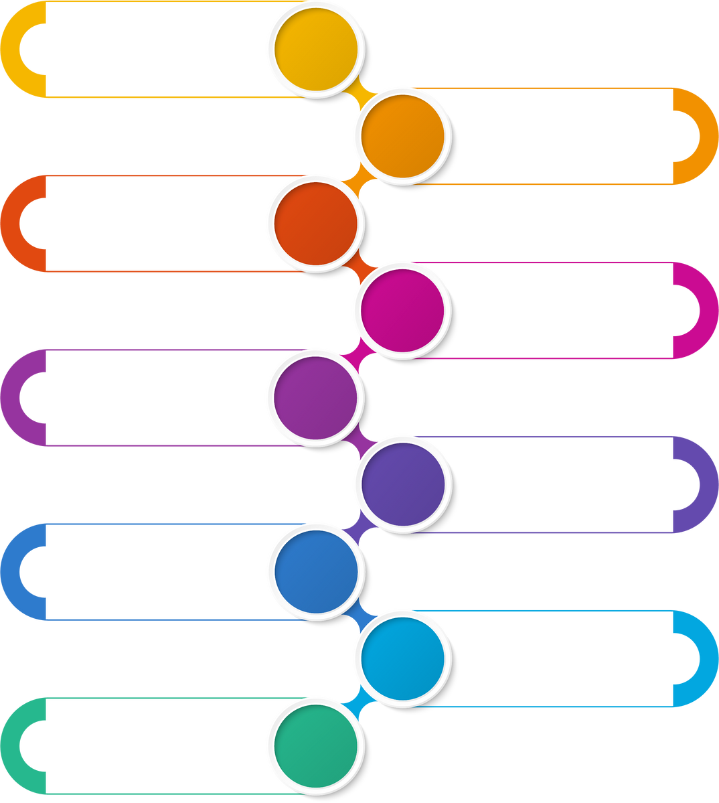

FLOWCHART
Introduction
Understanding the Iris Dataset
Data Preparation
Splitting Training and Testing Data
Logistic Regression Model
Data Visualization
Model Evaluation
Conclusion
Finish

Slide 4

Introduction
Iris Dataset
Objective
To build a classification model using Logistic Regression to predict Iris species based on available features.
A renowned dataset used in various machine learning studies and tutorials.
Notes:
2

Slide 5
Understanding the Iris Dataset
Sepal Length (cm)
Sepal Width (cm)
Petal Length (cm)
Petal Width (cm)
Target (Species)
5.1
3.5
1.4
0.2
0 (Setosa)
4.9
3.0
1.4
0.2
0 (Setosa)
4.7
3.2
1.3
0.2
0 (Setosa)
4.6
3.1
1.5
0.2
0 (Setosa)
5.0
3.6
1.4
0.2
0 (Setosa)
5.4
3.9
1.7
0.4
0 (Setosa)
4.6
3.4
1.4
0.3
0 (Setosa)
5.0
3.4
1.5
0.2
0 (Setosa)
4.4
2.9
1.4
0.2
0 (Setosa)
The dataset contains 150 samples of Iris flowers, divided into three species: Setosa, Versicolor, and Virginica.
Notes:
3

Slide 6
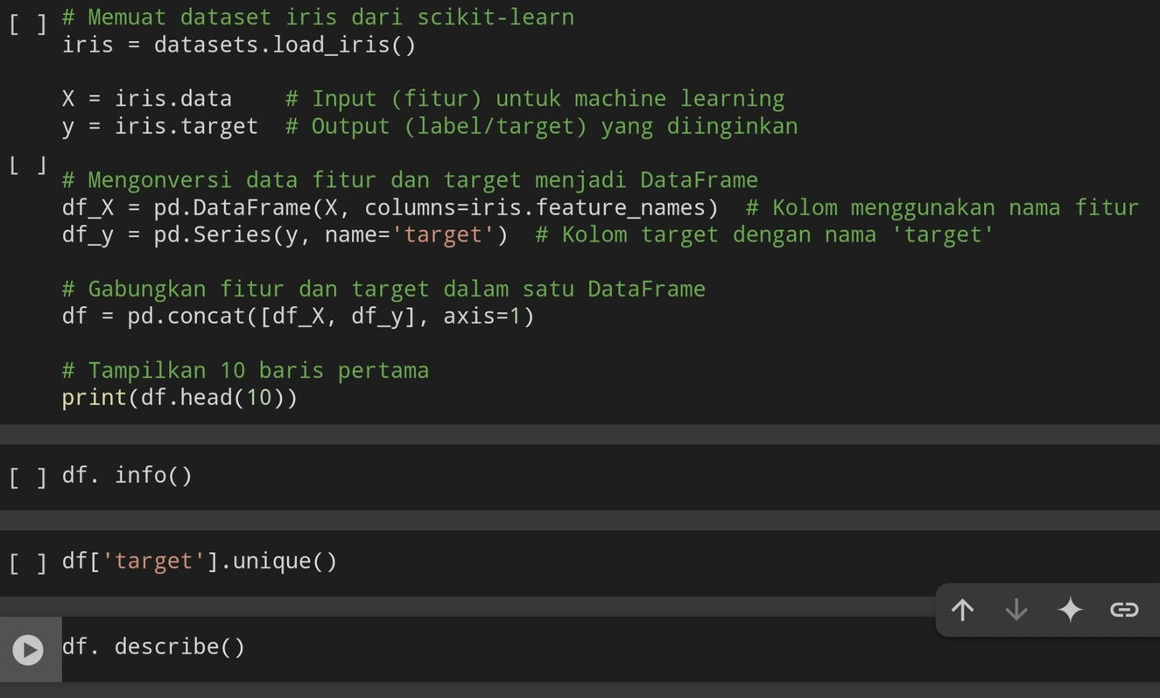
Data Preparation
1
Load Iris Dataset
Load the Iris dataset from `sklearn.datasets`.
Separate Features and Target
2
Separate the features (`X`) and target (`y`) variables.
3
Combine Features and Target
Combine features and target into a single DataFrame for easier visualization and analysis.
Notes:
4

Slide 7
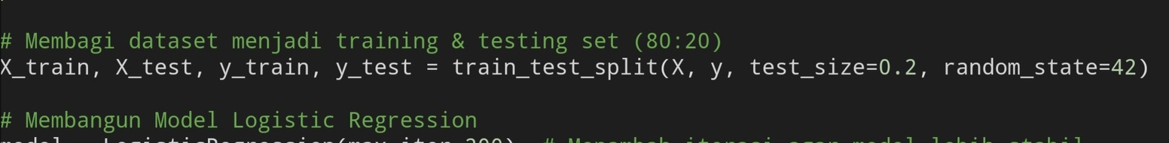
Splitting Data into Training and Testing Sets
Training Set
Testing Set
80% of the dataset used to train the model.
20% of the dataset used to evaluate the model's performance.
The dataset is split using the `train_test_split` function from `sklearn`.
Notes:
5

Slide 8


Logistic Regression Model
Logistic Regression is used to predict the probability of a target class (in this case, Iris species) based on the available features.
The training process uses the training data to build the model.
Notes:
6

Slide 9
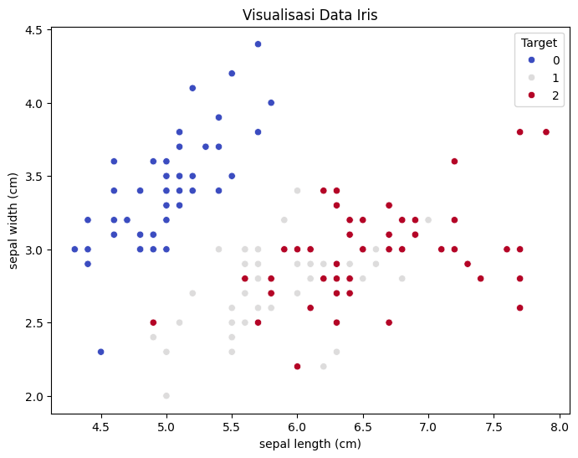
Scatter Plot: Sepal Length vs Sepal Width
🔵 Setosa
Distinct cluster
The data forms a separate and well-defined cluster with no overlap.
⚫ Versicolor
Overlaps with Virginica
The data is spread in the middle and overlaps with Virginica, making classification harder.
🔴 Virginica
Distinguishable trend
The data is more widely spread but follows a recognizable trend compared to Versicolor.

Slide 10
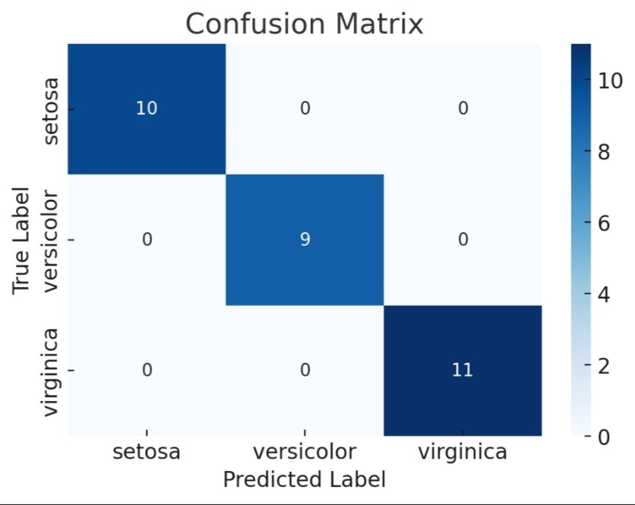
Model Evaluation
Accuracy Score
Classification Report
Measures the model's success rate in predicting the test data.
Displays metrics like Precision, Recall, and F1-Score for each class (Setosa, Versicolor, Virginica).
Confusion Matrix
Compares predicted labels with actual labels.
Notes:
7

Slide 11

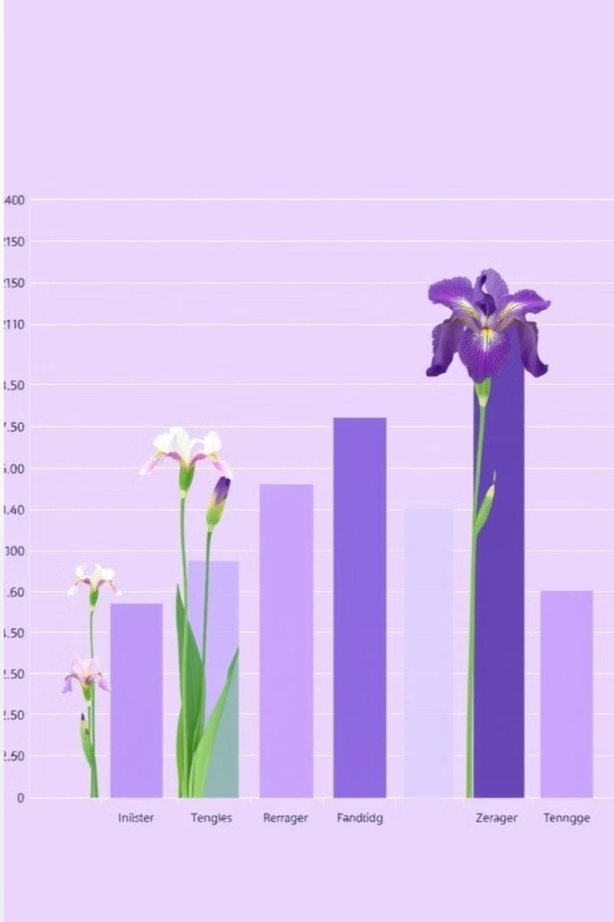
Conclusion
Logistic Regression successfully predicted Iris species with a high accuracy rate. The evaluation results demonstrate the model's strong performance in classifying the Iris dataset. This dataset can be used to test other classification models
Notes:
8

Slide 12






Contact with me
Hai Everyone!
Nabila Adzra Salsabil
Mahasiswi Semester 4 Teknik Informatika
Universitas Pamulang
Data Science| Data Analys
nabilaadzra26@gmail.com
Nabila Adzra Salsabil
nbladzr
@nbladzr_

Slide 13

Thank you
For watching

